Slide 1
SmartSms
PRESENTED BY
091793: Mercy
092191: Carlton
091775: Kizi

Slide 2

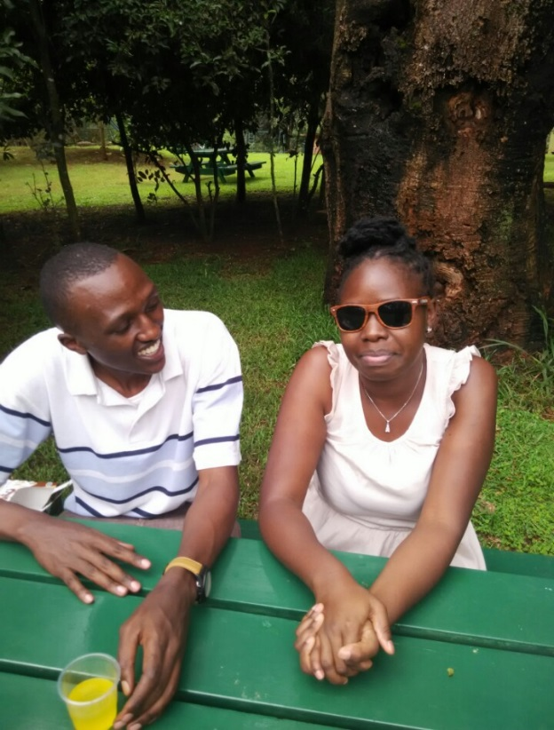
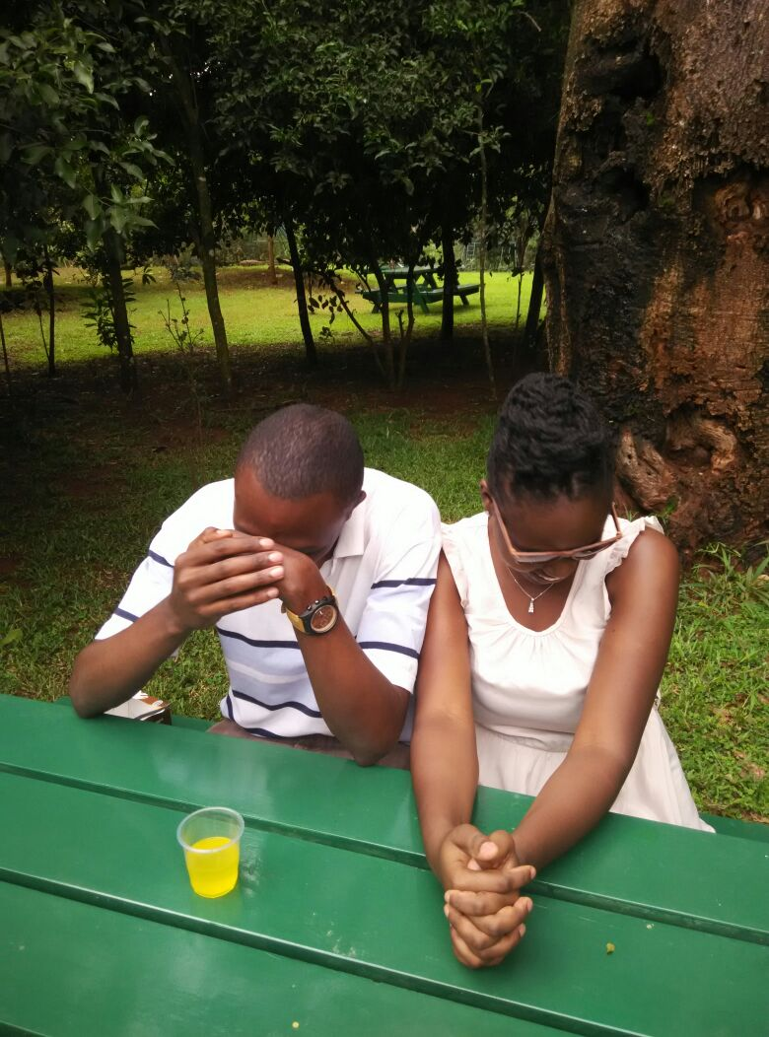

Background
I will never forget your birthday bae

Slide 3
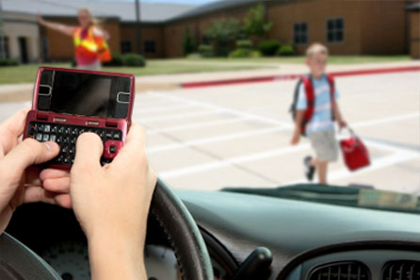
Problem

Slide 4
Solution
Intelligent auto responder
SMS time scheduler
Location scheduler
Personalized SMS responder

Slide 5
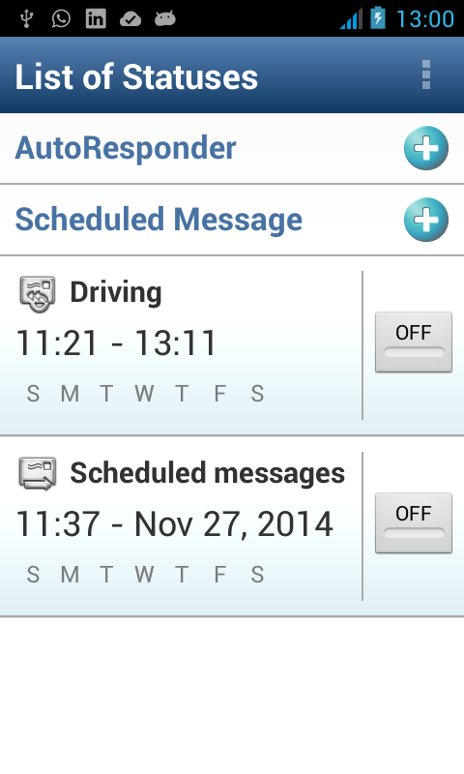
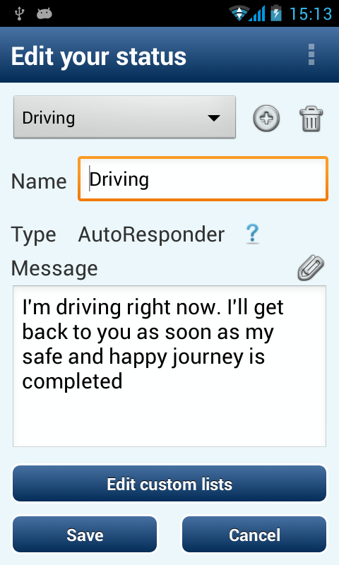
SMS AutoResponder

Slide 6
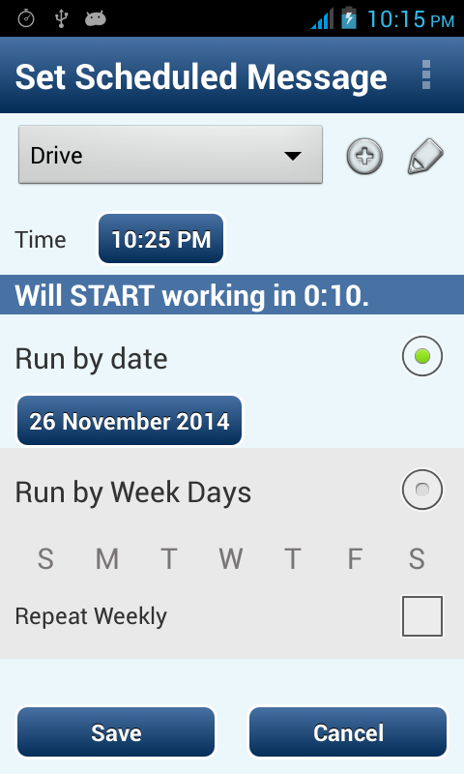
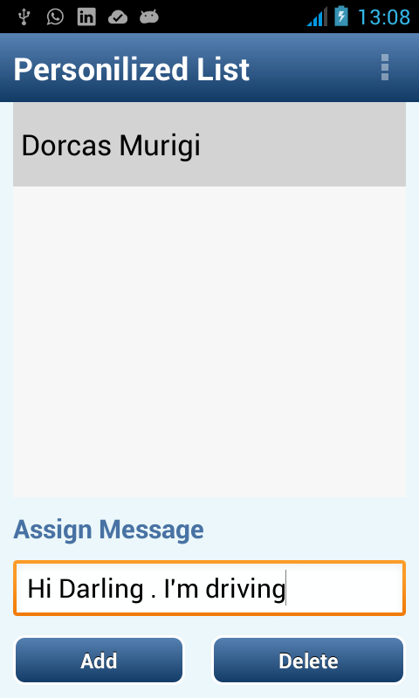
Personalized list

Slide 7
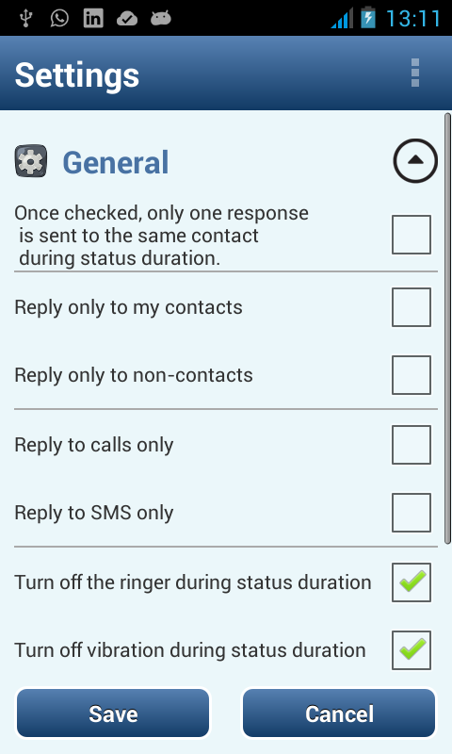
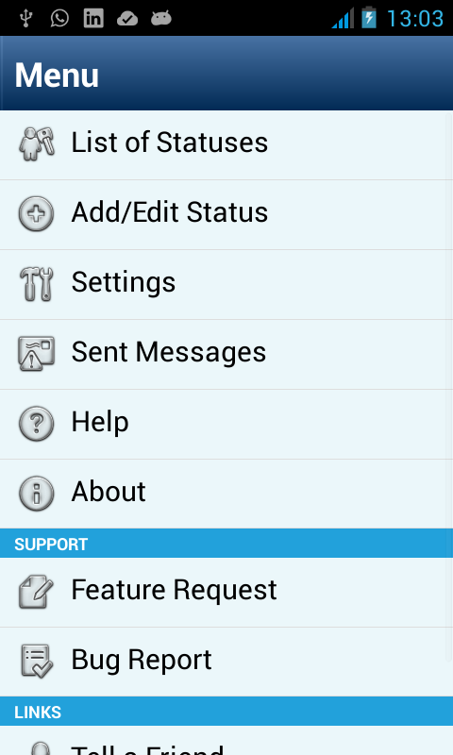
Settings

Slide 8
Solution architecture
User Interface
Background Mode
SMS responder
SQLite Database

Slide 9
THANK YOU FOR YOUR TIME

